Slide 1
Jermyn Borough Council Meeting
1/20/22

Slide 2
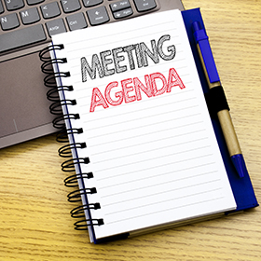
Meeting Agenda
January 20, 2022
CALL TO ORDER
PLEDGE OF ALLEGIANCE
ROLL CALL
PREVIOUS MEETING MINUTES(12/16/21 and 1/3/2022
TREASURER REPORT/BILLS PAYABLE
CORRESPONDENCE
PUBLIC COMMENT
PROFESSIONAL REPORTS
POLICE
FIRE
EMA
SOLICITOR
CODE ENFORCEMENT
ZONING
ENGINEER
TAX COLLECTOR
MAYOR
COMMITTEE ASSIGNMENTS
R&L FIRE HYDRANT ISSUE
RENTAL MEMORANDUM OF UNDERSTANDING
COUNTY WASTE
VOLUNTEERS FOR BOARDS/ORGINAZATIONS
FUTURE MEETINGS

Slide 3
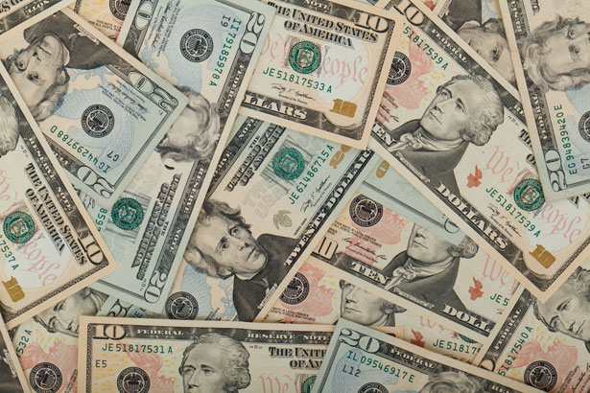
Treasurer’s report
1/20/22
ASSETS
Checking/Savings
Capital Reserve - DPW 10,725.94
Capital Reserve - Police 4,606.82
Crime Watch Fund 222.69
General Fund - Community 111,977.72
General Fund - FNB 4,389.95
Holiday Lights Fund 1,778.91

Slide 4
Treasurer’s report
Investment - General Fund 1,001.60
Investment - Liquid Fuels 33,816.37
Investment - Paving Fund 1,011.96
Investment - Recycling 5,003.76
Investment - Refuse 2,600.39
Liquid Fuels - FNB 16,482.23
Petty Cash 231.00
Recreations Fund 17,122.98
Recycling - Community 8,673.76
Refuse Checking - FNB 40,010.50
Total Checking/Savings 259,656.58

Slide 5
Treasurer’s report
200000 · Accounts Payable 24,161.26

Slide 6


